Slide 1

Panama Electricity Load Forecasting
Group 3
Supervisors: Assoc. Prof. Nguyễn Thị Kim Anh
Prof. Trần Việt Trung
Students:
Tạ Hữu Bình 20190094
Trần Trọng Hiệp 20190051
Nguyễn Văn Trung 20190071
Hà Đức Tuấn 20190072

Slide 2
Contents
Problem
Data
Models
Experiments
Conclusion

Slide 3
Contents
Problem
Data
Models
Experiments
Conclusion

Slide 4
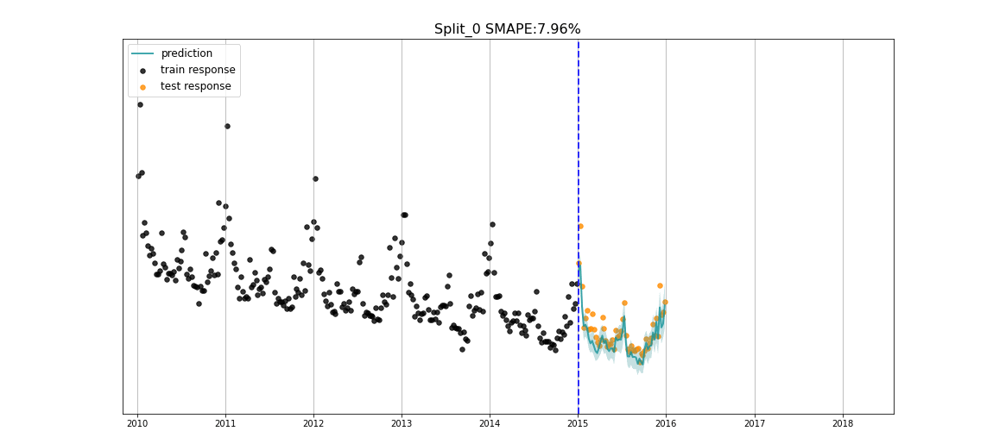
Time series forecasting problem
Electricity load forecasting is a key task for the effective operation and planning of power systems.
Panama Electricity Load Forecasting is a time-series problem to forecast the national electricity load.
The underlying intention of time series forecasting is determining how target variables will change in the future by observing historical data from the time perspective, defining the patterns, and yielding short or long-term
predictions on how
change occurs –
considering the
captured patterns.
Notes:
https://www.iqair.com/world-most-polluted-cities/world-air-quality-report-2021-en.pdf
https://www.weforum.org/agenda/2016/10/air-pollution-facts/
https://www.oecd.org/env/air-pollution-to-cause-6-9-million-premature-deaths-and-cost-1-gdp-by-2060.htm
https://www.stateofglobalair.org/health
https://en.wikipedia.org/wiki/Air_pollution_forecasting
https://agupubs.onlinelibrary.wiley.com/doi/full/10.1002/2017JD028052

Slide 5
Taxonomies
Inputs vs. Outputs
Inputs: history time steps (1h).
Outputs: future time steps (1h).
Endogenous vs. Exogenous
Exogenous: school day, holiday.
Exogenous: others
Regression vs. Classification
Univariate vs. Multivariate
Single-step vs. Multi-step
Contiguous vs. Discontiguous
Notes:
http://www.careourearth.com/wp-content/uploads/2018/02/Real-time-AQI-Visual-Map_Berkeley.jpg
https://www.iqair.com/world-air-quality-ranking
https://www.weforum.org/agenda/2016/10/air-pollution-facts/
https://www.iqair.com/world-most-polluted-cities/world-air-quality-report-2021-en.pdf
https://www.careourearth.com/real-time-air-quality-index-visual-map-excellent/
https://www.orfonline.org/expert-speak/taking-on-a-burning-problem-mumbais-air-pollution/

Slide 6
Contents
Problem
Data
Models
Experiments
Conclusion

Slide 7
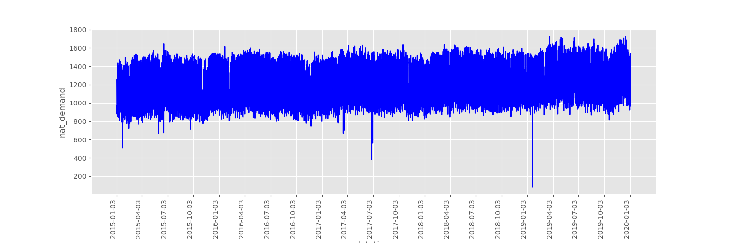
Panama Electric Load dataset
Source: Kaggle https://www.kaggle.com/datasets/pateljay731/panama-electricity-load-forecasting
Forecast national electricity load.
Number of variables measured to forecast: 14
Notes:
http://www.careourearth.com/wp-content/uploads/2018/02/Real-time-AQI-Visual-Map_Berkeley.jpg
https://www.iqair.com/world-air-quality-ranking
https://www.weforum.org/agenda/2016/10/air-pollution-facts/
https://www.iqair.com/world-most-polluted-cities/world-air-quality-report-2021-en.pdf
https://www.careourearth.com/real-time-air-quality-index-visual-map-excellent/
https://www.orfonline.org/expert-speak/taking-on-a-burning-problem-mumbais-air-pollution/

Slide 8
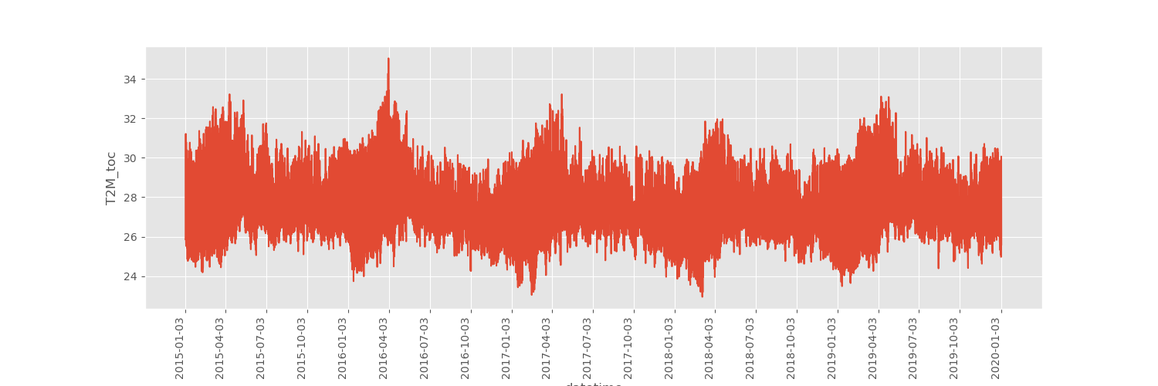
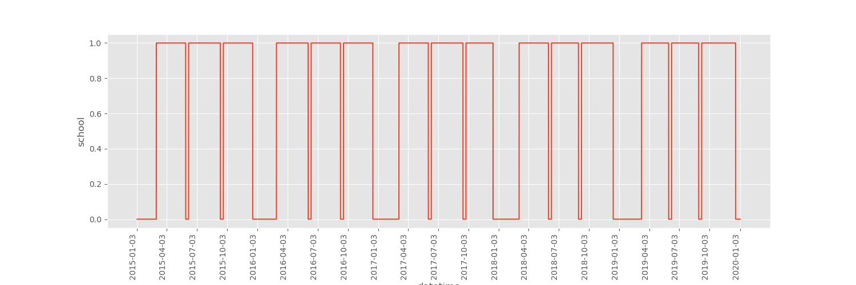
Temperature and school day through time
Notes:
http://www.careourearth.com/wp-content/uploads/2018/02/Real-time-AQI-Visual-Map_Berkeley.jpg
https://www.iqair.com/world-air-quality-ranking
https://www.weforum.org/agenda/2016/10/air-pollution-facts/
https://www.iqair.com/world-most-polluted-cities/world-air-quality-report-2021-en.pdf
https://www.careourearth.com/real-time-air-quality-index-visual-map-excellent/
https://www.orfonline.org/expert-speak/taking-on-a-burning-problem-mumbais-air-pollution/

Slide 9
Contents
Problem
Data
Models
Conventional approaches
Deep Learning approaches
Experiments
Conclusion

Slide 10
Vector autoregression (VAR)
Inputs vs. Outputs
Notes:
http://www.careourearth.com/wp-content/uploads/2018/02/Real-time-AQI-Visual-Map_Berkeley.jpg
https://www.iqair.com/world-air-quality-ranking
https://www.weforum.org/agenda/2016/10/air-pollution-facts/
https://www.iqair.com/world-most-polluted-cities/world-air-quality-report-2021-en.pdf
https://www.careourearth.com/real-time-air-quality-index-visual-map-excellent/
https://www.orfonline.org/expert-speak/taking-on-a-burning-problem-mumbais-air-pollution/

Slide 11
Facebook Prophet (FbProphet)
Inputs vs. Outputs
Notes:
http://www.careourearth.com/wp-content/uploads/2018/02/Real-time-AQI-Visual-Map_Berkeley.jpg
https://www.iqair.com/world-air-quality-ranking
https://www.weforum.org/agenda/2016/10/air-pollution-facts/
https://www.iqair.com/world-most-polluted-cities/world-air-quality-report-2021-en.pdf
https://www.careourearth.com/real-time-air-quality-index-visual-map-excellent/
https://www.orfonline.org/expert-speak/taking-on-a-burning-problem-mumbais-air-pollution/

Slide 12
Recurrent neural network (RNN)
Inputs vs. Outputs
Notes:
http://www.careourearth.com/wp-content/uploads/2018/02/Real-time-AQI-Visual-Map_Berkeley.jpg
https://www.iqair.com/world-air-quality-ranking
https://www.weforum.org/agenda/2016/10/air-pollution-facts/
https://www.iqair.com/world-most-polluted-cities/world-air-quality-report-2021-en.pdf
https://www.careourearth.com/real-time-air-quality-index-visual-map-excellent/
https://www.orfonline.org/expert-speak/taking-on-a-burning-problem-mumbais-air-pollution/

Slide 13
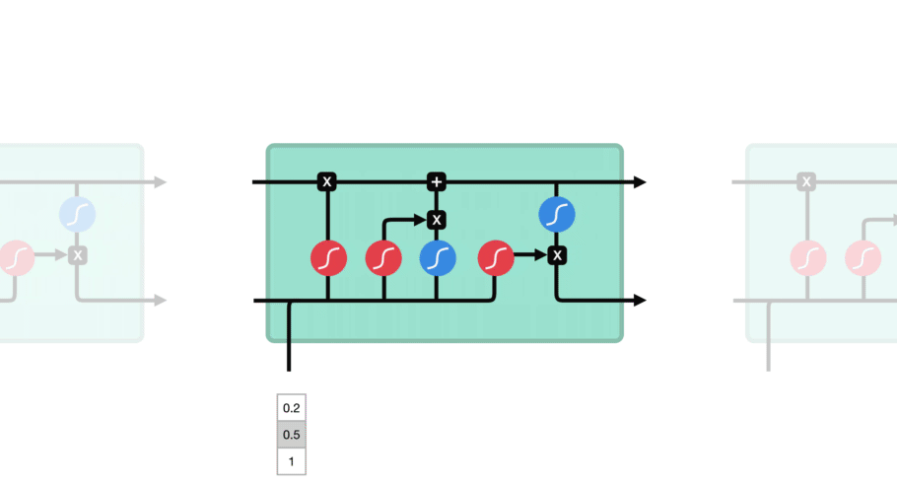
Long-short term memory (LSTM)
Inputs vs. Outputs
Notes:
http://www.careourearth.com/wp-content/uploads/2018/02/Real-time-AQI-Visual-Map_Berkeley.jpg
https://www.iqair.com/world-air-quality-ranking
https://www.weforum.org/agenda/2016/10/air-pollution-facts/
https://www.iqair.com/world-most-polluted-cities/world-air-quality-report-2021-en.pdf
https://www.careourearth.com/real-time-air-quality-index-visual-map-excellent/
https://www.orfonline.org/expert-speak/taking-on-a-burning-problem-mumbais-air-pollution/

Slide 14
Bidirectional LSTM
Inputs vs. Outputs
Notes:
http://www.careourearth.com/wp-content/uploads/2018/02/Real-time-AQI-Visual-Map_Berkeley.jpg
https://www.iqair.com/world-air-quality-ranking
https://www.weforum.org/agenda/2016/10/air-pollution-facts/
https://www.iqair.com/world-most-polluted-cities/world-air-quality-report-2021-en.pdf
https://www.careourearth.com/real-time-air-quality-index-visual-map-excellent/
https://www.orfonline.org/expert-speak/taking-on-a-burning-problem-mumbais-air-pollution/

Slide 15
Contents
Problem
Data
Models
Experiments
Experimental settings
VAR and Prophet
Deep Learning
Conclusion

Slide 16
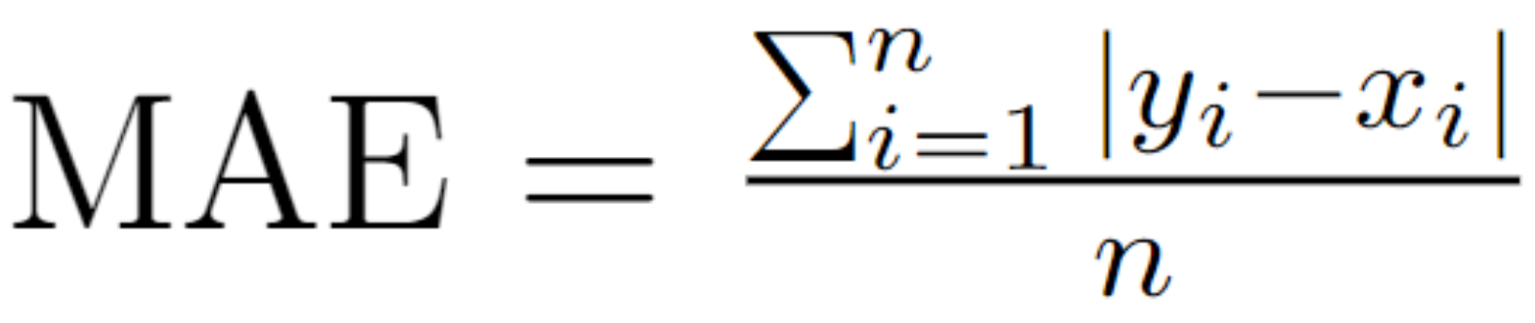
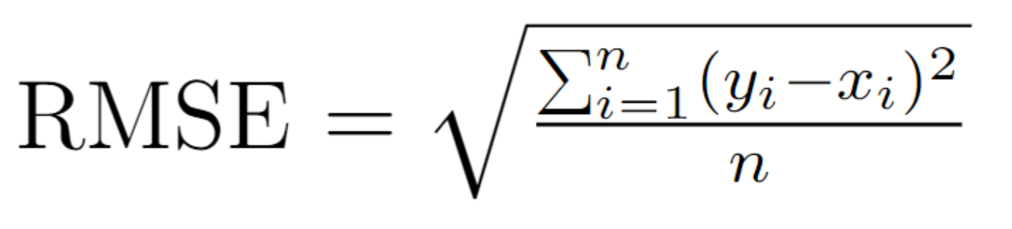
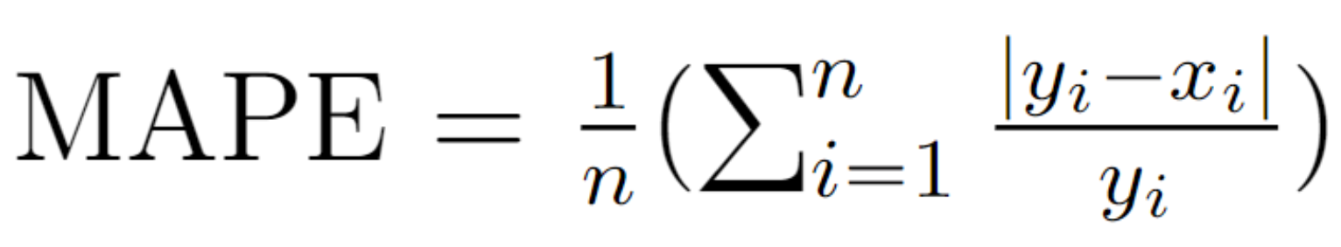
Experimental settings
Loss:
Models:
VAR
FbProphet
LSTM and its variants
GRU
Notes:
http://www.careourearth.com/wp-content/uploads/2018/02/Real-time-AQI-Visual-Map_Berkeley.jpg
https://www.iqair.com/world-air-quality-ranking
https://www.weforum.org/agenda/2016/10/air-pollution-facts/
https://www.iqair.com/world-most-polluted-cities/world-air-quality-report-2021-en.pdf
https://www.careourearth.com/real-time-air-quality-index-visual-map-excellent/
https://www.orfonline.org/expert-speak/taking-on-a-burning-problem-mumbais-air-pollution/

Slide 17
Test scenarios
Measure the performance of two traditional approaches → Benchmarks.
Impact of history on the performance of Deep Learning models → Find proper number of history time steps.
Usefulness of clipping techniques → Whether the abnormally low value of the National electricity load cause negative effect.
Performance of models when forecasting different number of future time steps → When Deep Learning models helpful.
Test the endurance → Can models perform well without retraing.
Notes:
http://www.careourearth.com/wp-content/uploads/2018/02/Real-time-AQI-Visual-Map_Berkeley.jpg
https://www.iqair.com/world-air-quality-ranking
https://www.weforum.org/agenda/2016/10/air-pollution-facts/
https://www.iqair.com/world-most-polluted-cities/world-air-quality-report-2021-en.pdf
https://www.careourearth.com/real-time-air-quality-index-visual-map-excellent/
https://www.orfonline.org/expert-speak/taking-on-a-burning-problem-mumbais-air-pollution/

Slide 18
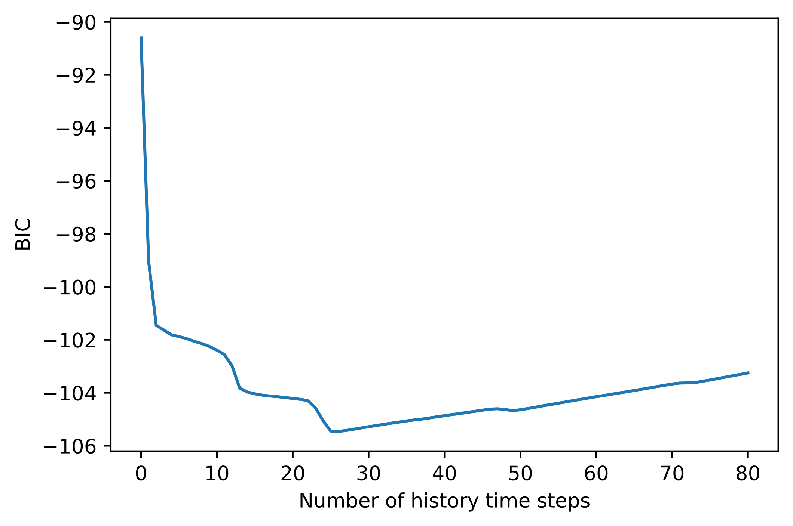
VAR - Bayesian Information Criterion
Best order (number of history time steps used to predict) is 26
Notes:
http://www.careourearth.com/wp-content/uploads/2018/02/Real-time-AQI-Visual-Map_Berkeley.jpg
https://www.iqair.com/world-air-quality-ranking
https://www.weforum.org/agenda/2016/10/air-pollution-facts/
https://www.iqair.com/world-most-polluted-cities/world-air-quality-report-2021-en.pdf
https://www.careourearth.com/real-time-air-quality-index-visual-map-excellent/
https://www.orfonline.org/expert-speak/taking-on-a-burning-problem-mumbais-air-pollution/

Slide 19
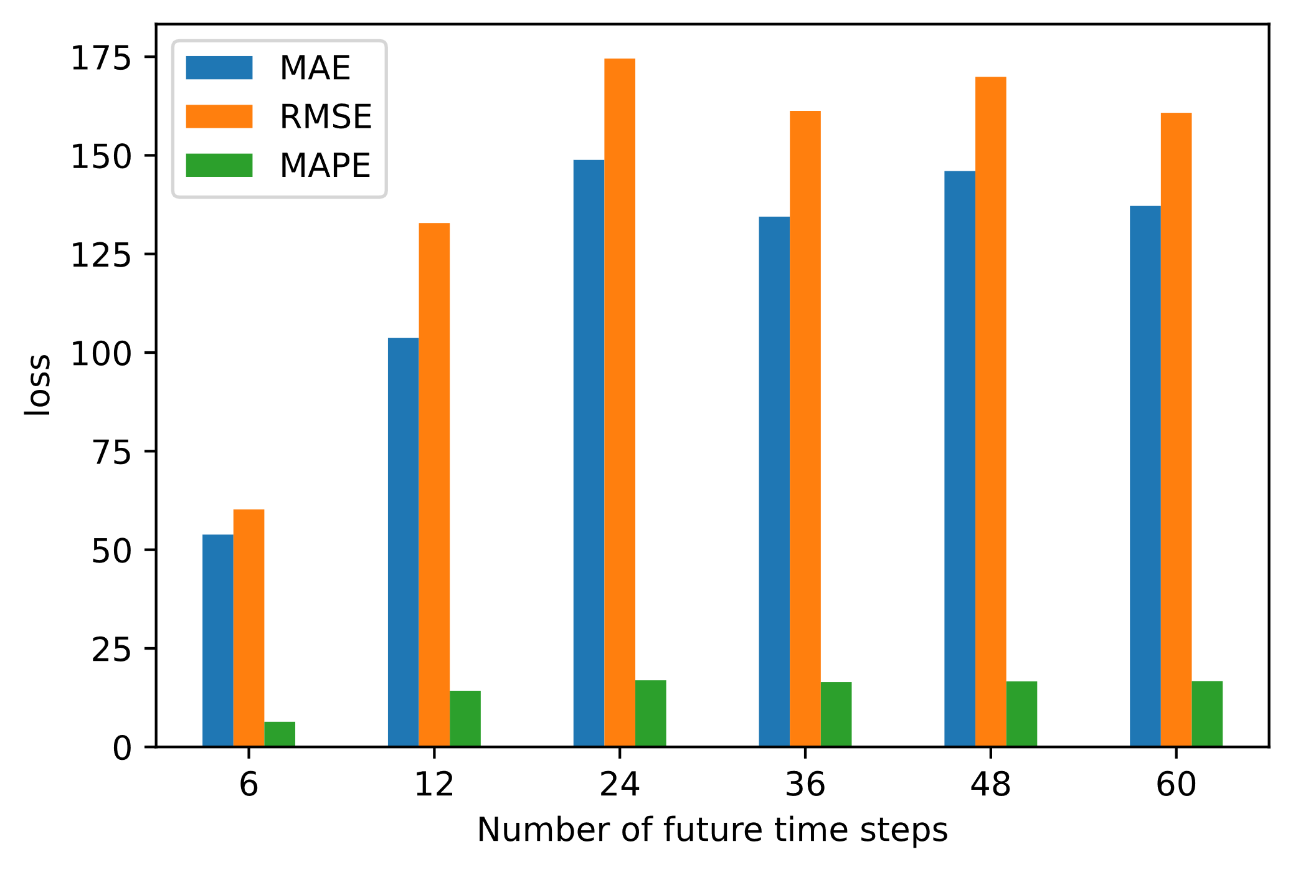
Performance of VAR
Notes:
http://www.careourearth.com/wp-content/uploads/2018/02/Real-time-AQI-Visual-Map_Berkeley.jpg
https://www.iqair.com/world-air-quality-ranking
https://www.weforum.org/agenda/2016/10/air-pollution-facts/
https://www.iqair.com/world-most-polluted-cities/world-air-quality-report-2021-en.pdf
https://www.careourearth.com/real-time-air-quality-index-visual-map-excellent/
https://www.orfonline.org/expert-speak/taking-on-a-burning-problem-mumbais-air-pollution/

Slide 20
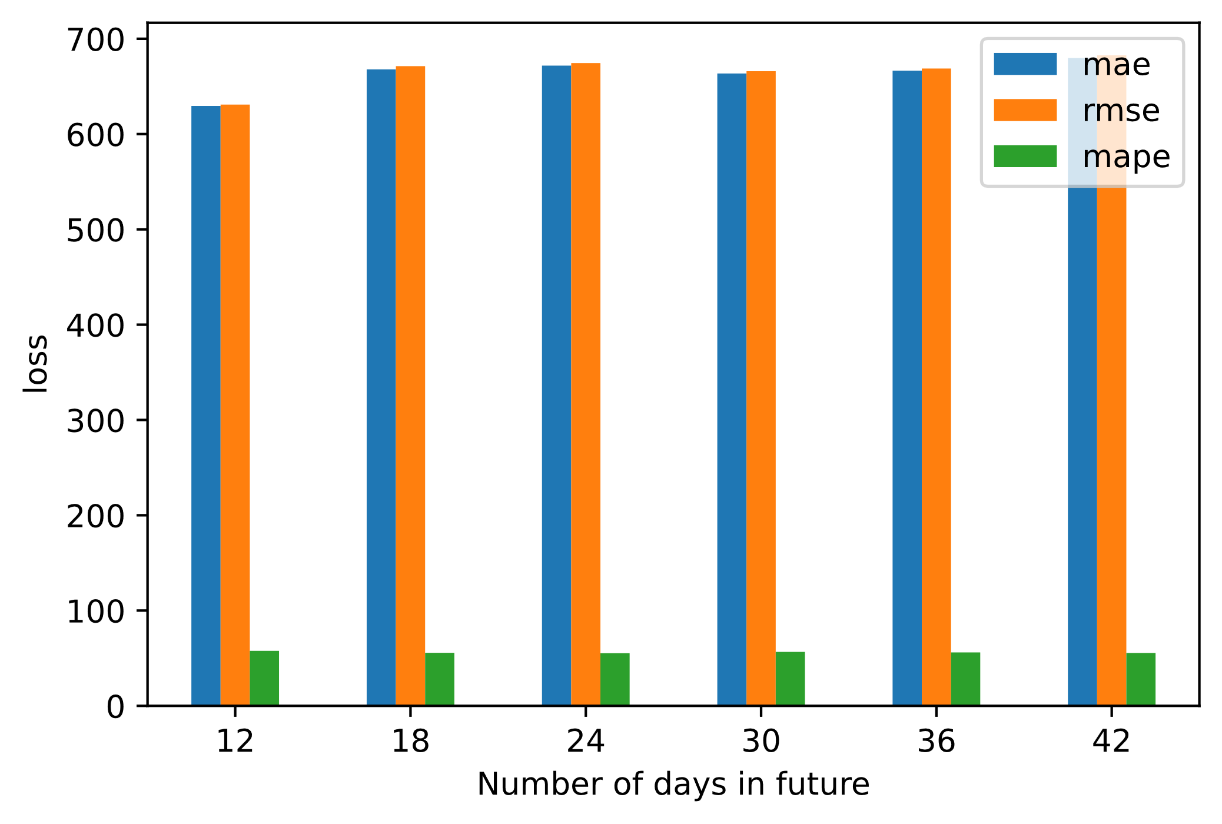
Performance of Facebook Prophet
Notes:
http://www.careourearth.com/wp-content/uploads/2018/02/Real-time-AQI-Visual-Map_Berkeley.jpg
https://www.iqair.com/world-air-quality-ranking
https://www.weforum.org/agenda/2016/10/air-pollution-facts/
https://www.iqair.com/world-most-polluted-cities/world-air-quality-report-2021-en.pdf
https://www.careourearth.com/real-time-air-quality-index-visual-map-excellent/
https://www.orfonline.org/expert-speak/taking-on-a-burning-problem-mumbais-air-pollution/

Slide 21
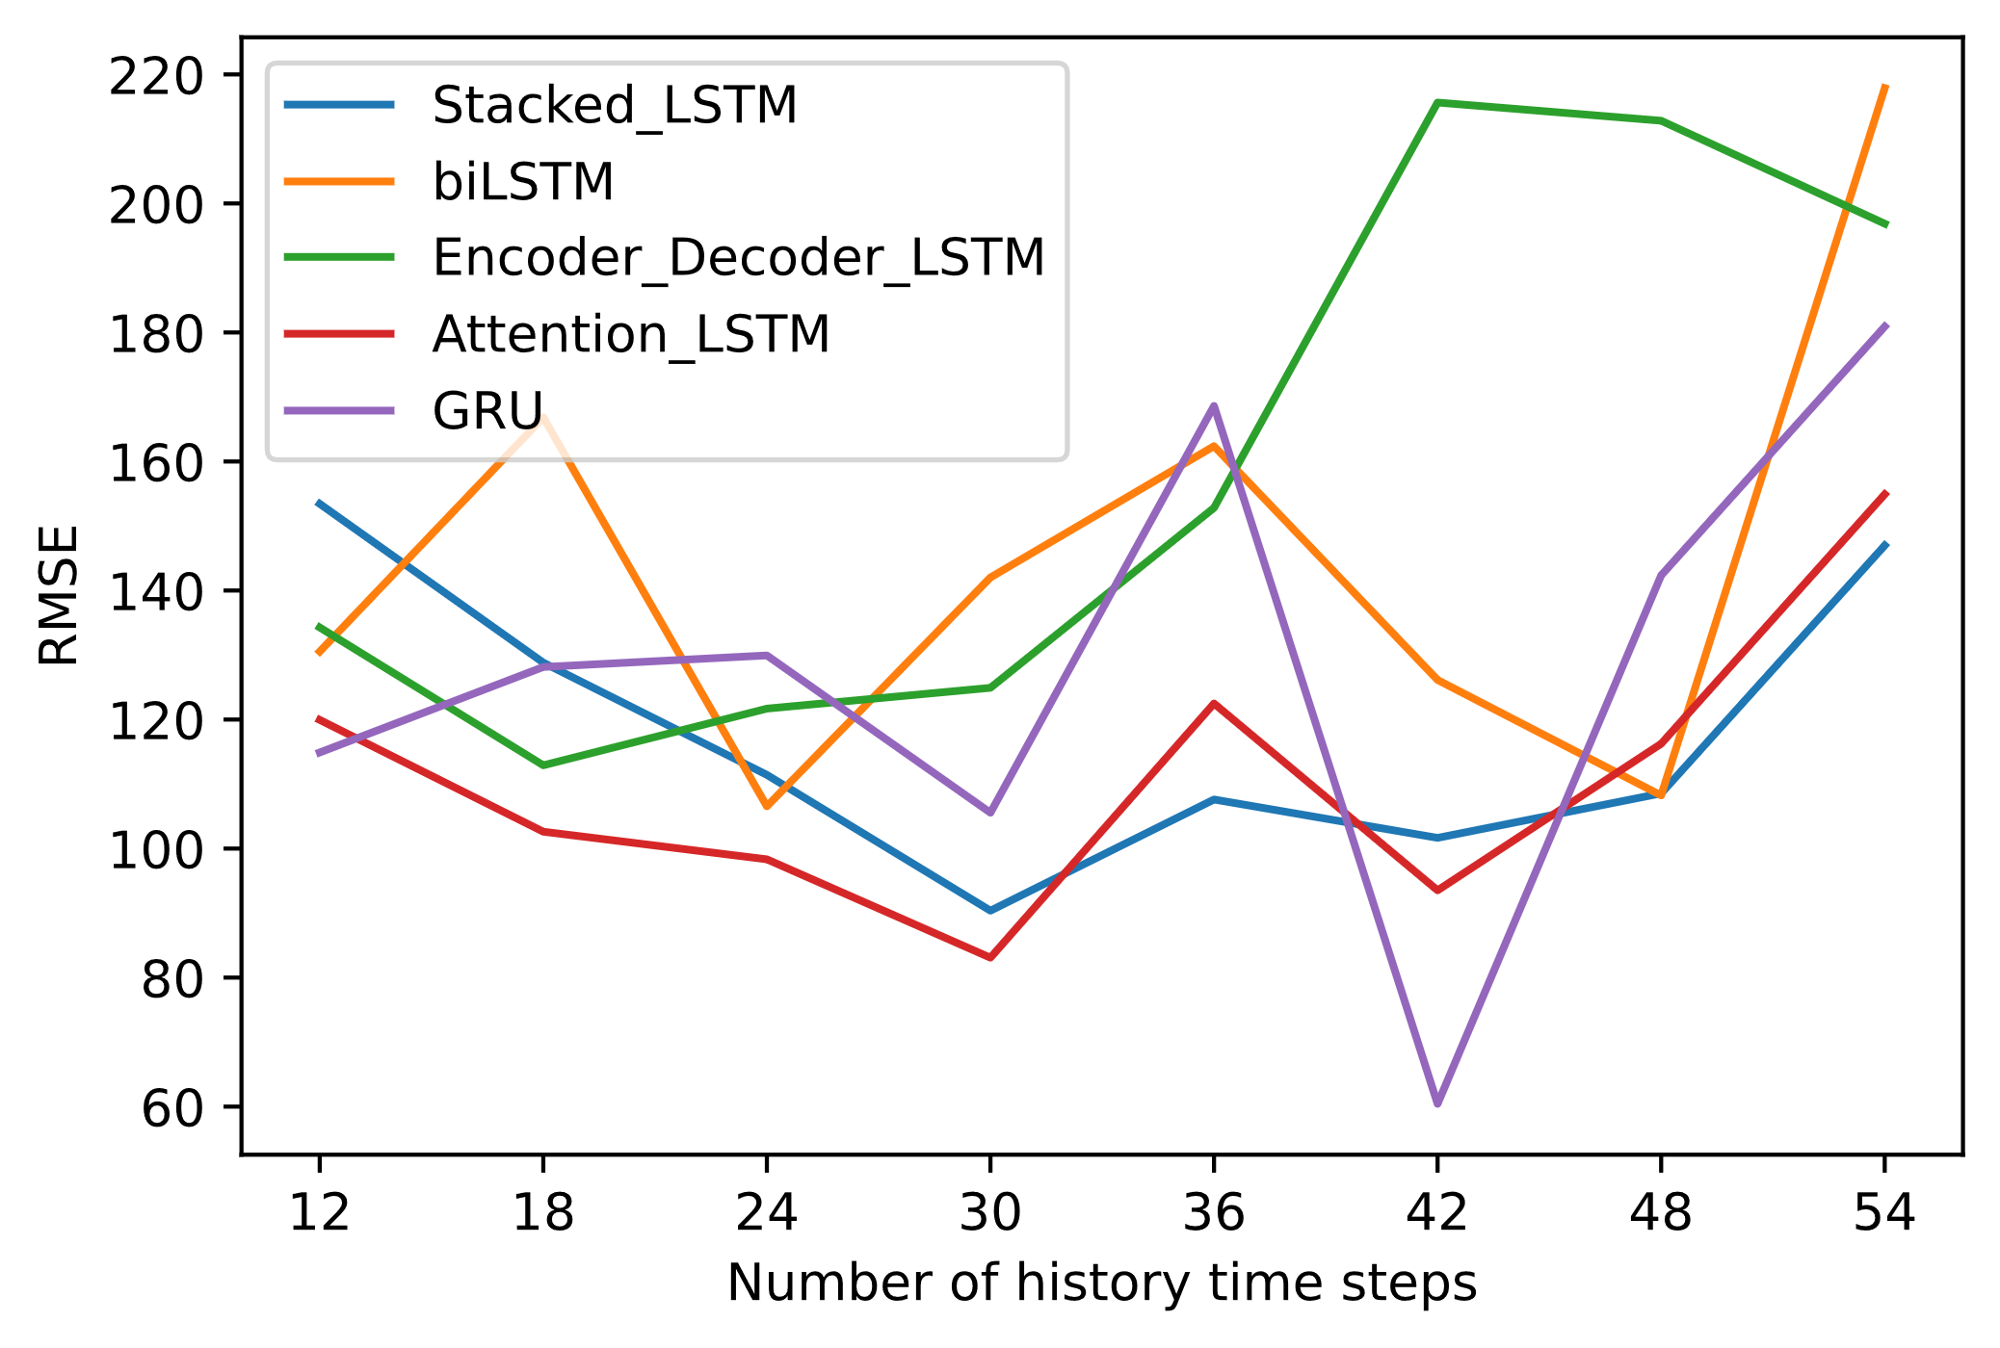
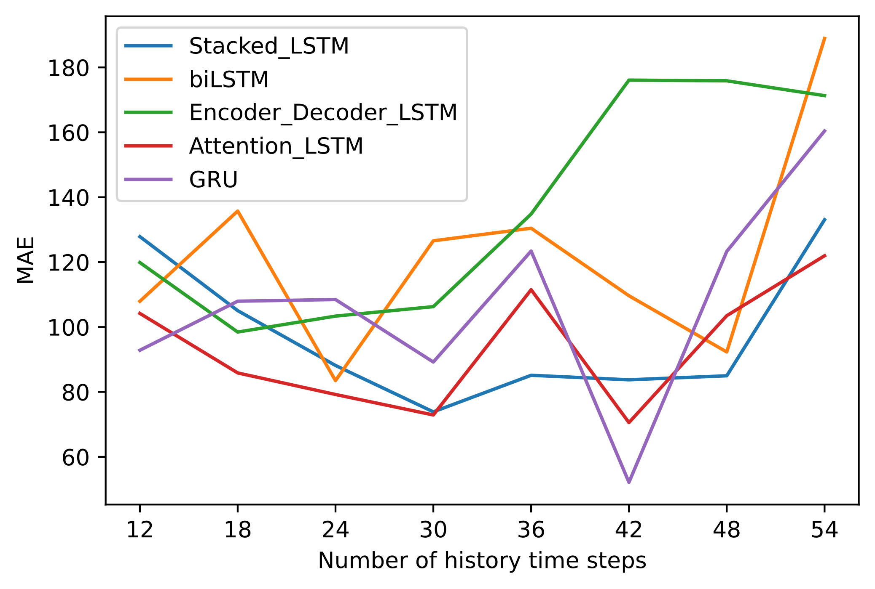
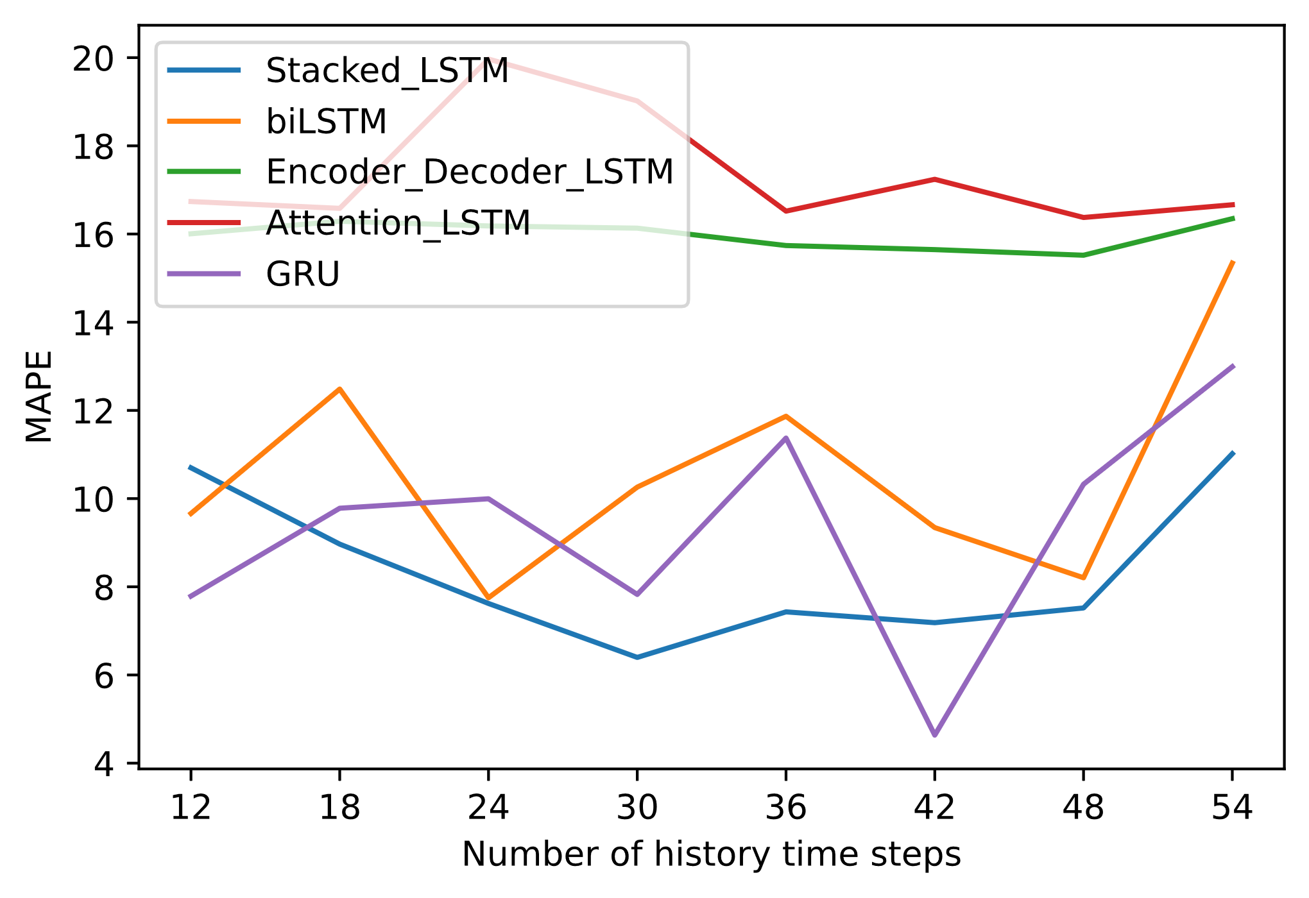
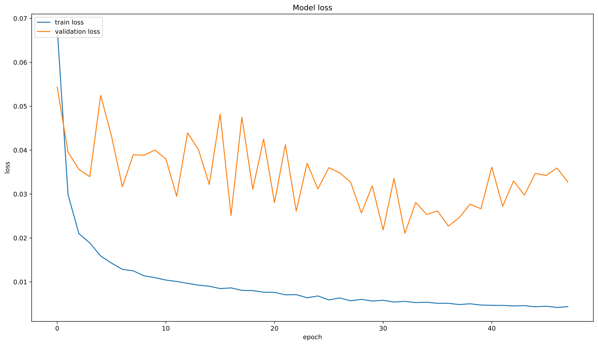
Impact of history time steps Deep Learning
Notes:
http://www.careourearth.com/wp-content/uploads/2018/02/Real-time-AQI-Visual-Map_Berkeley.jpg
https://www.iqair.com/world-air-quality-ranking
https://www.weforum.org/agenda/2016/10/air-pollution-facts/
https://www.iqair.com/world-most-polluted-cities/world-air-quality-report-2021-en.pdf
https://www.careourearth.com/real-time-air-quality-index-visual-map-excellent/
https://www.orfonline.org/expert-speak/taking-on-a-burning-problem-mumbais-air-pollution/

Slide 22
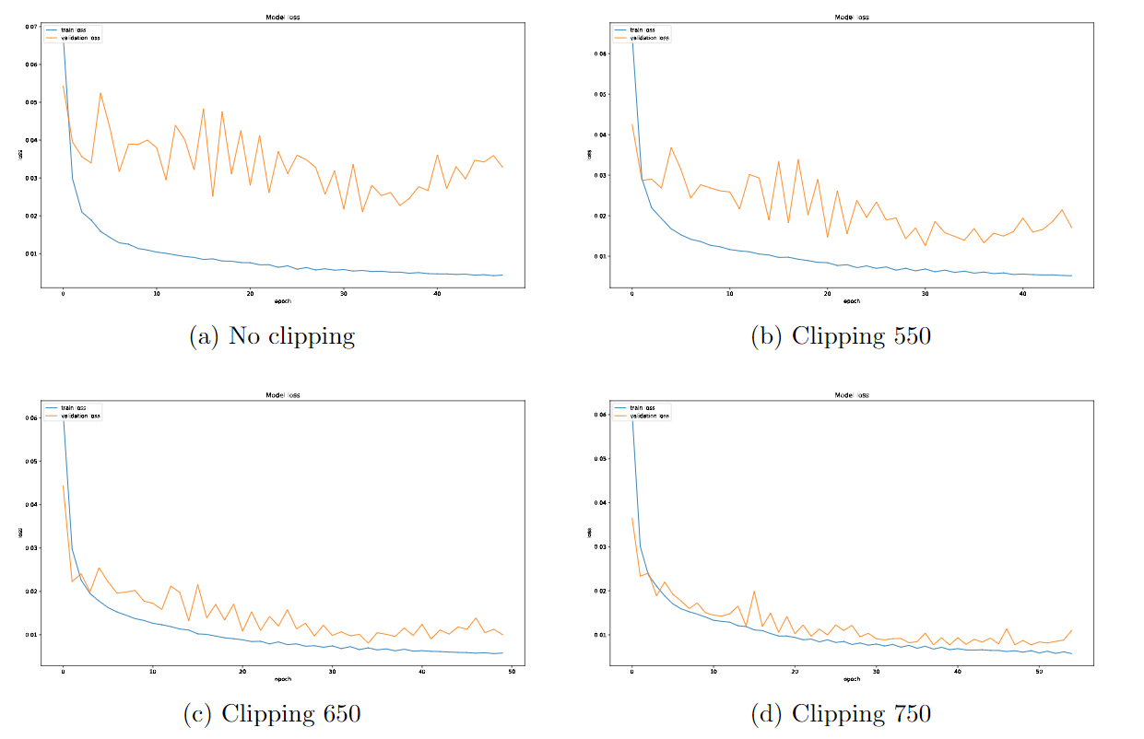
Effect of clipping technique
Notes:
http://www.careourearth.com/wp-content/uploads/2018/02/Real-time-AQI-Visual-Map_Berkeley.jpg
https://www.iqair.com/world-air-quality-ranking
https://www.weforum.org/agenda/2016/10/air-pollution-facts/
https://www.iqair.com/world-most-polluted-cities/world-air-quality-report-2021-en.pdf
https://www.careourearth.com/real-time-air-quality-index-visual-map-excellent/
https://www.orfonline.org/expert-speak/taking-on-a-burning-problem-mumbais-air-pollution/

Slide 23
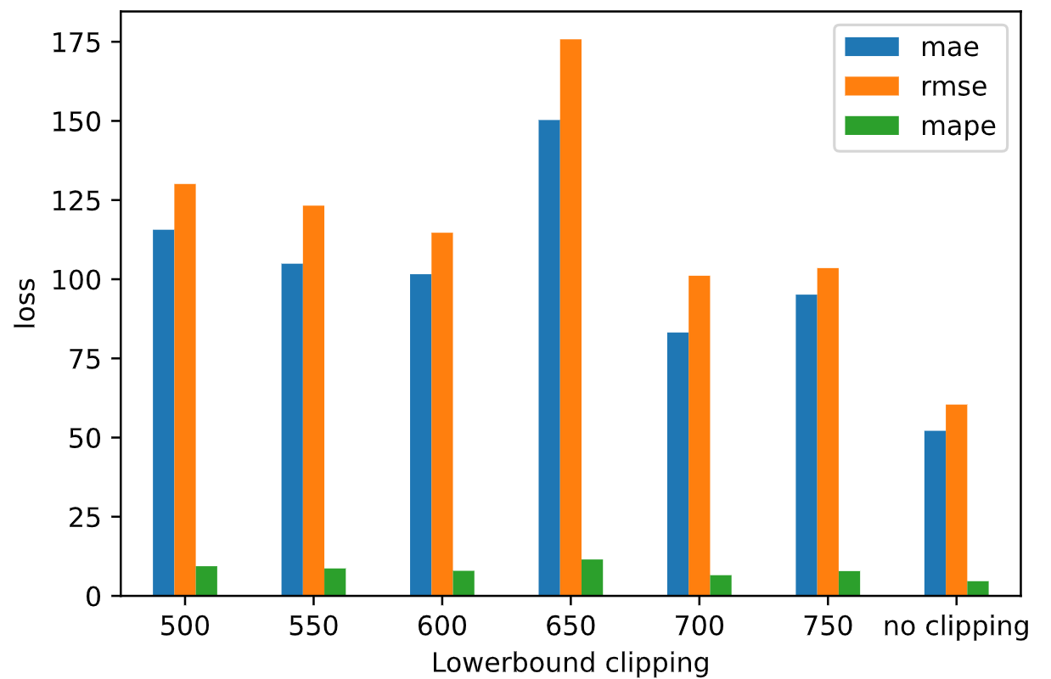
Effect of clipping technique
Notes:
http://www.careourearth.com/wp-content/uploads/2018/02/Real-time-AQI-Visual-Map_Berkeley.jpg
https://www.iqair.com/world-air-quality-ranking
https://www.weforum.org/agenda/2016/10/air-pollution-facts/
https://www.iqair.com/world-most-polluted-cities/world-air-quality-report-2021-en.pdf
https://www.careourearth.com/real-time-air-quality-index-visual-map-excellent/
https://www.orfonline.org/expert-speak/taking-on-a-burning-problem-mumbais-air-pollution/

Slide 24

Impact future time steps
Notes:
http://www.careourearth.com/wp-content/uploads/2018/02/Real-time-AQI-Visual-Map_Berkeley.jpg
https://www.iqair.com/world-air-quality-ranking
https://www.weforum.org/agenda/2016/10/air-pollution-facts/
https://www.iqair.com/world-most-polluted-cities/world-air-quality-report-2021-en.pdf
https://www.careourearth.com/real-time-air-quality-index-visual-map-excellent/
https://www.orfonline.org/expert-speak/taking-on-a-burning-problem-mumbais-air-pollution/

Slide 25
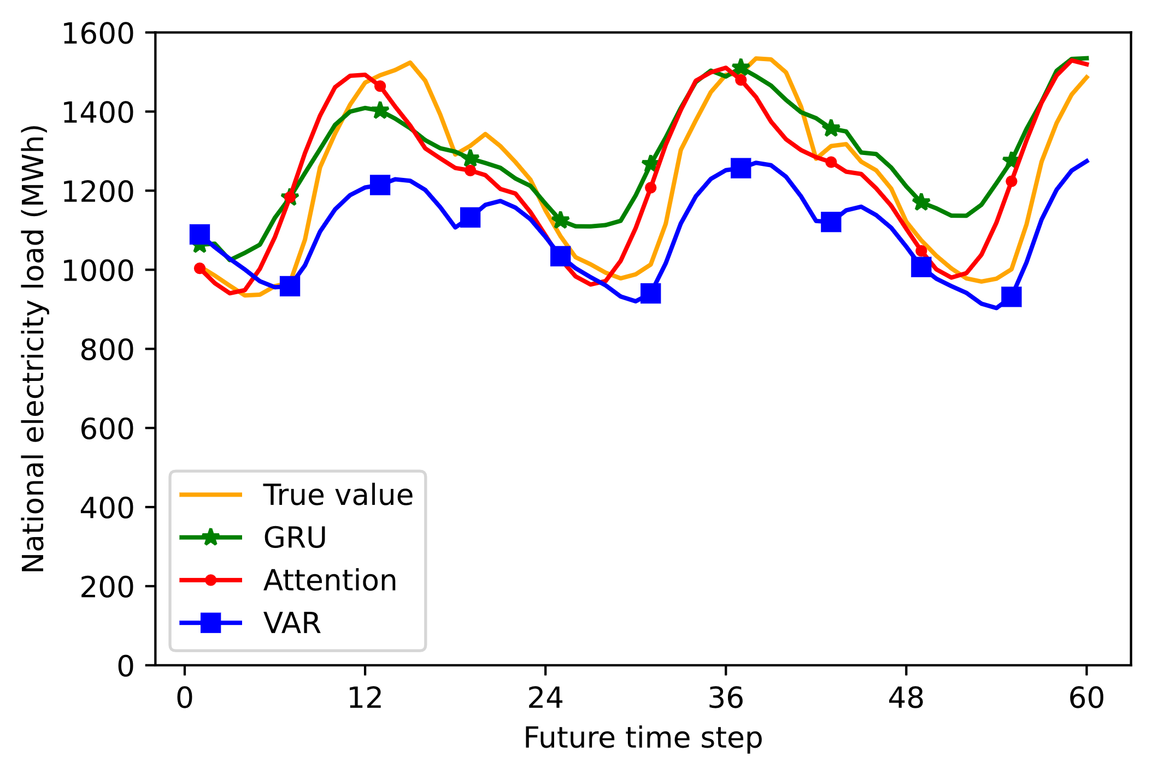
Forecast vs Actual
Notes:
http://www.careourearth.com/wp-content/uploads/2018/02/Real-time-AQI-Visual-Map_Berkeley.jpg
https://www.iqair.com/world-air-quality-ranking
https://www.weforum.org/agenda/2016/10/air-pollution-facts/
https://www.iqair.com/world-most-polluted-cities/world-air-quality-report-2021-en.pdf
https://www.careourearth.com/real-time-air-quality-index-visual-map-excellent/
https://www.orfonline.org/expert-speak/taking-on-a-burning-problem-mumbais-air-pollution/

Slide 26
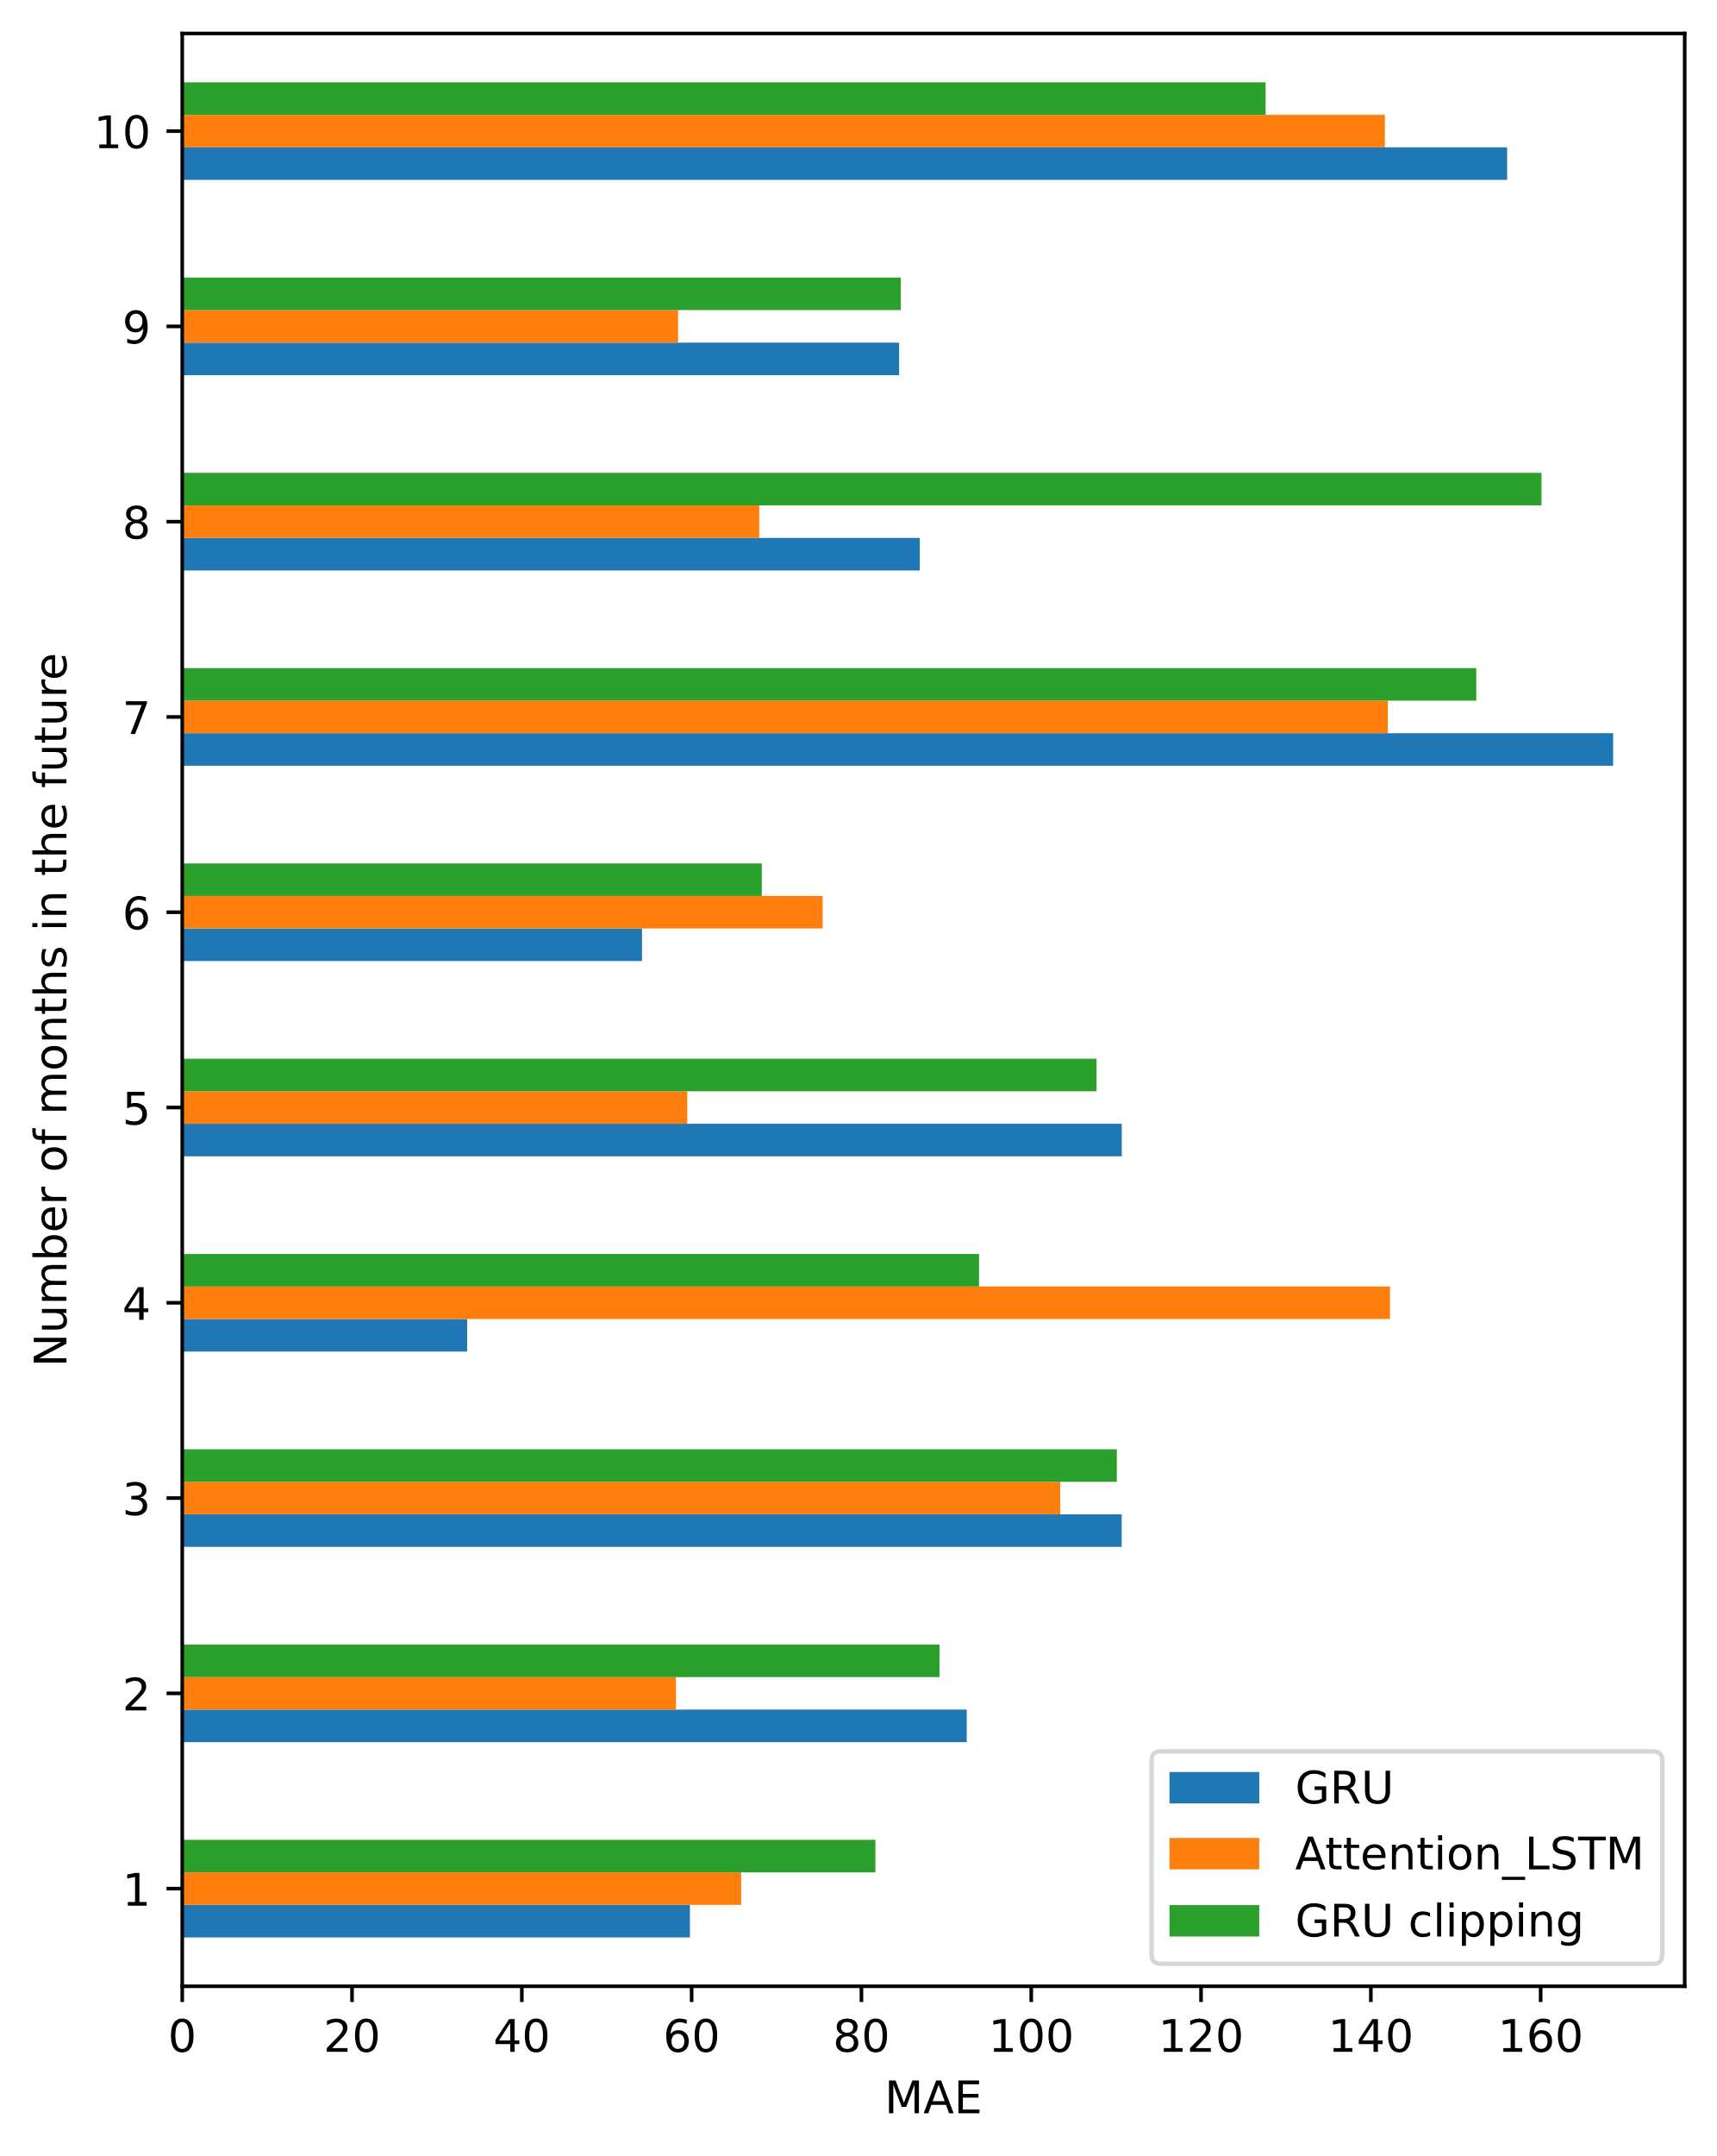
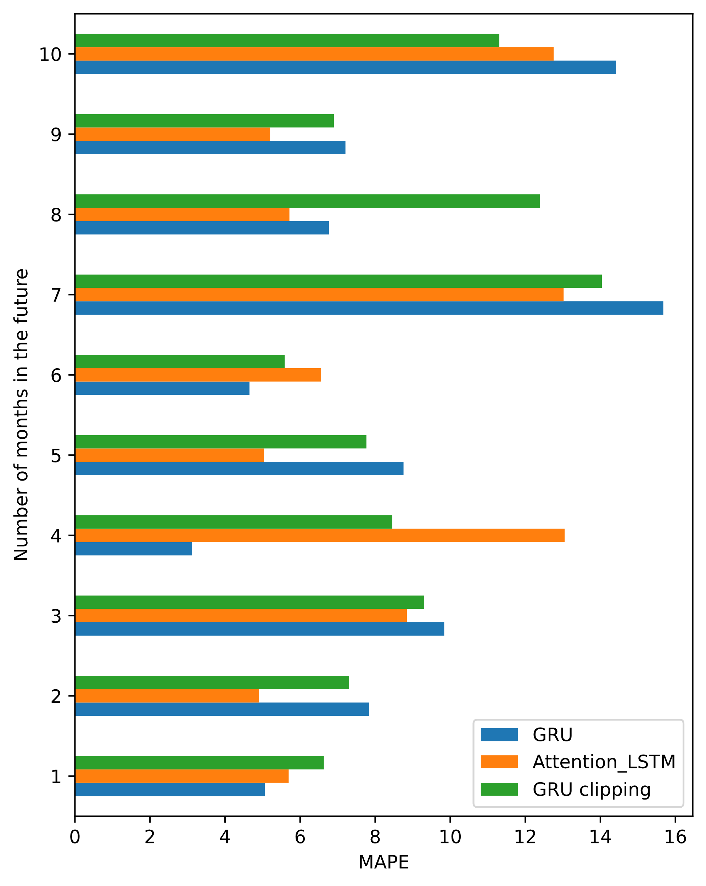
Endurance of Deep Learning models
Notes:
http://www.careourearth.com/wp-content/uploads/2018/02/Real-time-AQI-Visual-Map_Berkeley.jpg
https://www.iqair.com/world-air-quality-ranking
https://www.weforum.org/agenda/2016/10/air-pollution-facts/
https://www.iqair.com/world-most-polluted-cities/world-air-quality-report-2021-en.pdf
https://www.careourearth.com/real-time-air-quality-index-visual-map-excellent/
https://www.orfonline.org/expert-speak/taking-on-a-burning-problem-mumbais-air-pollution/

Slide 27
Contents
Problem
Data
Models
Experiments
Conclusion

Slide 28
Conclusion
Present the problem.
Data to use
Proposal:
Moving average
LSTM + Attention mechanism
Experiments:
RMSE and MAPE as error metrics.
Observe the impact of hyper-parameters
Comparing performance of proposed models

Slide 29
THANK YOU !

